Slide 1
Vulnerabilities Identified and Mitigation Strategies in Case Study

Slide 2
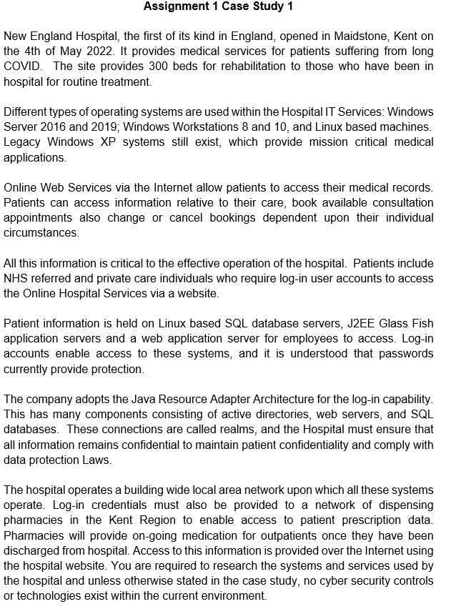
Case Study

Slide 3
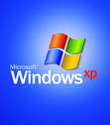
Vulnerabilities Identified
Legacy Systems (Windows XP):
Risk: Unsupported OS with no security patches, leading to high vulnerability to exploits.
Mitigation: Replace Windows XP with modern, supported OS. If immediate replacement is impossible, isolate XP systems in a segmented network, restrict internet access, and implement additional monitoring.

Slide 4

Vulnerabilities Identified
Weak Authentication Mechanisms:
Risk: Reliance on passwords alone increases risks of phishing, brute-force attacks, and credential theft.
Mitigation: Implement Multi-Factor Authentication (MFA) for all user accounts (patients, employees, pharmacies). Enforce strong password policies (e.g., minimum length, complexity, regular rotation).

Slide 5

Vulnerabilities Identified
External Access Risks (Pharmacies):
Risk: Pharmacies access patient data over the internet without secure channels, risking data breaches.
Mitigation: Implement a VPN with strict access controls for external pharmacies. Restrict access to only necessary data using role-based access control (RBAC).

Slide 6
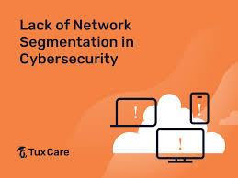
Vulnerabilities Identified
Lack of Network Segmentation:
Risk: All systems operate on a single LAN, allowing lateral movement if compromised.
Mitigation: Segment the network into zones (e.g., legacy systems, databases, web servers) with firewalls between segments. Use Intrusion Detection/Prevention Systems (IDS/IPS) to monitor traffic.

Slide 7

Vulnerabilities Identified
Insufficient Security Controls:
Risk: No mention of firewalls, encryption at rest, or endpoint protection.
Mitigation:
Deploy next-generation firewalls to filter inbound/outbound traffic.
Encrypt sensitive data at rest (e.g., SQL databases) using AES-256.
Install endpoint protection (antivirus, EDR) on all devices.

Slide 8
Vulnerabilities Identified
Outdated Java Components (J2EE GlassFish/Resource Adapter):
Risk: Older Java frameworks may have unpatched vulnerabilities (e.g., Log4j-style exploits) or insecure configurations.
Mitigation:
Update J2EE/GlassFish to the latest supported versions.
Conduct code reviews for legacy Java applications to identify insecure dependencies.
Use Web Application Firewalls (WAFs) to block known exploit patterns.

Slide 9
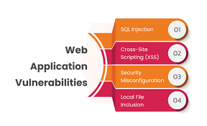
Vulnerabilities Identified
Web Application Vulnerabilities:
Risk: Patient portal features (e.g., appointment booking) may be susceptible to SQL injection, cross-site scripting (XSS), or broken access controls.
Mitigation:
Perform regular penetration testing on web applications.
Implement input validation and parameterized queries to prevent SQLi.
Enforce strict session management (e.g., short timeouts, secure cookies).

Slide 10
Vulnerabilities Identified
Physical Security Gaps:
Risk: Unsecured server rooms or workstations could allow physical tampering.
Mitigation:
Restrict physical access to IT infrastructure with biometrics/keycards.
Implement disk encryption for all portable devices.

Slide 11
What’s next on the agenda?
Break: 20 minutes
Lab Explanation
Lab Work

Slide 12


